Slide 1
Why do LLMs struggle with this task?
Suppose I have a program named foo.exe on my computer. foo.exe takes many weird command-line arguments.
I prompt Agent Mode:
“Run foo.exe on every .py file in my project.”
What are some things that will go wrong?

Slide 2
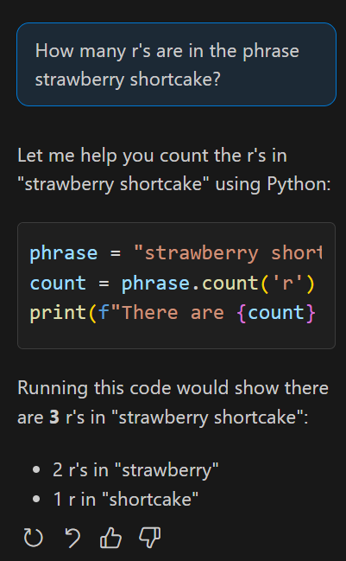
LLMs cannot be relied on for determinism
Notes:
Claude 3.5

Slide 3


Letting LLMs run code they write is dangerous
LLM
Terminal

Slide 4
Model Context Protocol
An LLM-friendly way for LLMs to
learn about tools on the system, and
deterministically alter the outside world
in a controlled manner.

Slide 5


Conceptual architecture of Agent + MCP
LLMs
(are not Agents)
Inputs
IDE
Desc.
Agent
(aka MCP Client)
Claude
Context
LLM-friendly description Resources and Tools
GPT
MCP JSON
MCP JSON
MCP Server (you write this code)
Raw output
Deterministic calls
Gemini
Resources and Tools
Command line
Files
DB
Web services

Slide 6

Conceptual data flow of Agent + MCP
Tools
MCP JSON
Your code handles
the request.
Not the Agent.
Not the LLM.
MCP JSON
LLM
MCP Client
(Agent Mode)
MCP Server
(your code)

Slide 7
Worked example - add
add(a=3, b=5)
def add(a, b):
return a + b
Add three and five
Tools
add(a=3, b=5)
Tools:
add(a, b)
MCP JSON
Your code handles
the request.
Not the Agent.
Not the LLM.
8
MCP JSON
LLM
MCP Client
(Agent Mode)
MCP Server
(your code)
{ result: 8 }

Slide 8
Agent sends Tool Descriptions with Context
"tools": [
{
"name": "add",
"description": "Add two numbers",
"inputSchema": {
"properties": {
"a": {
"title": "a",
"type": "int"
},
"b": {
"title": "b",
"type": "int"
}
},
"required": [
"a",
"b"
]
}
}
]
Tools:
add(a, b)
Tools
LLM
Deep Dive: Understanding MCP Client-Server Communication with Agent and LLM | by James Tang | Medium

Slide 9
MCP Request object from LLM
{
"method": "tools/call",
"params": {
"name": "add",
"arguments": {
"a": 3,
"b": 5
}
}
}
add(a=3, b=5)
Tools
MCP JSON
LLM
MCP Client
(Agent Mode)
The LLM emits precise JSON in its response to the Agent.
(Nothing can possibly go wrong with this plan)

Slide 10
Agent Mode passes the JSON to your server.
Now your code can act on it.
{
"method": "tools/call",
"params": {
"name": "add",
"arguments": {
“a": 3,
“b": 5
}
}
}
MCP JSON
MCP Client
(Agent Mode)
MCP Server
(your code)
This has reduced to a very ordinary web-dev task.
{ result: 8 }

Slide 11
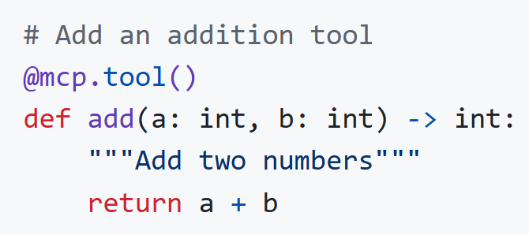
FastMCP abstracts out the JSON and server
{
"name": "add",
"arguments": {
“a": 3,
“b": 5
}
}
MCP Server
(your code)
https://github.com/modelcontextprotocol/python-sdk
The FastMCP Framework will generate an LLM-friendly description of this API from the code and annotations.

Slide 12
Testing MCP Servers with mcp.exe dev
Testing your MCP server requires no AI.
You can use the program mcp.exe dev to start a Web server that generates a UI for testing your MCP server.

Slide 13
Demos :
1. mcp.exe dev
2. MCP VS Code integration

Slide 14
Tips for writing MCP Servers

Slide 15
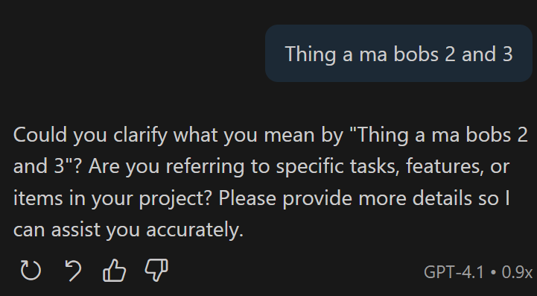
LLMs seem reluctant to call tools.
Modify your static prompt note their existence.
Modify your IDE’s “Instructions” or “Memories” to fix this.

Slide 16
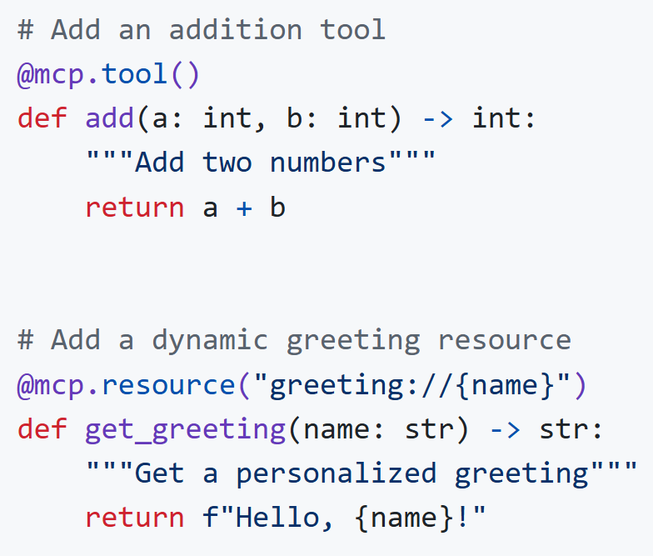
MCP Servers should follow REST conventions
MCP has parallels to REST:
  Resources: GET
  Tools: POST
No side effects from Resources
MCP Tools should be idempotent
Agent’s Context should hold state

Slide 17
Prefer Remote servers over Local servers
Local: JSON sent over Standard in, Standard Out
  Never print() on a Local MCP server
  mcp = FastMCP("Demo")
Remote: JSON sent over HTTP
  mcp = FastMCP("Demo", host="0.0.0.0", port="8080")
Same code otherwise.

Slide 18
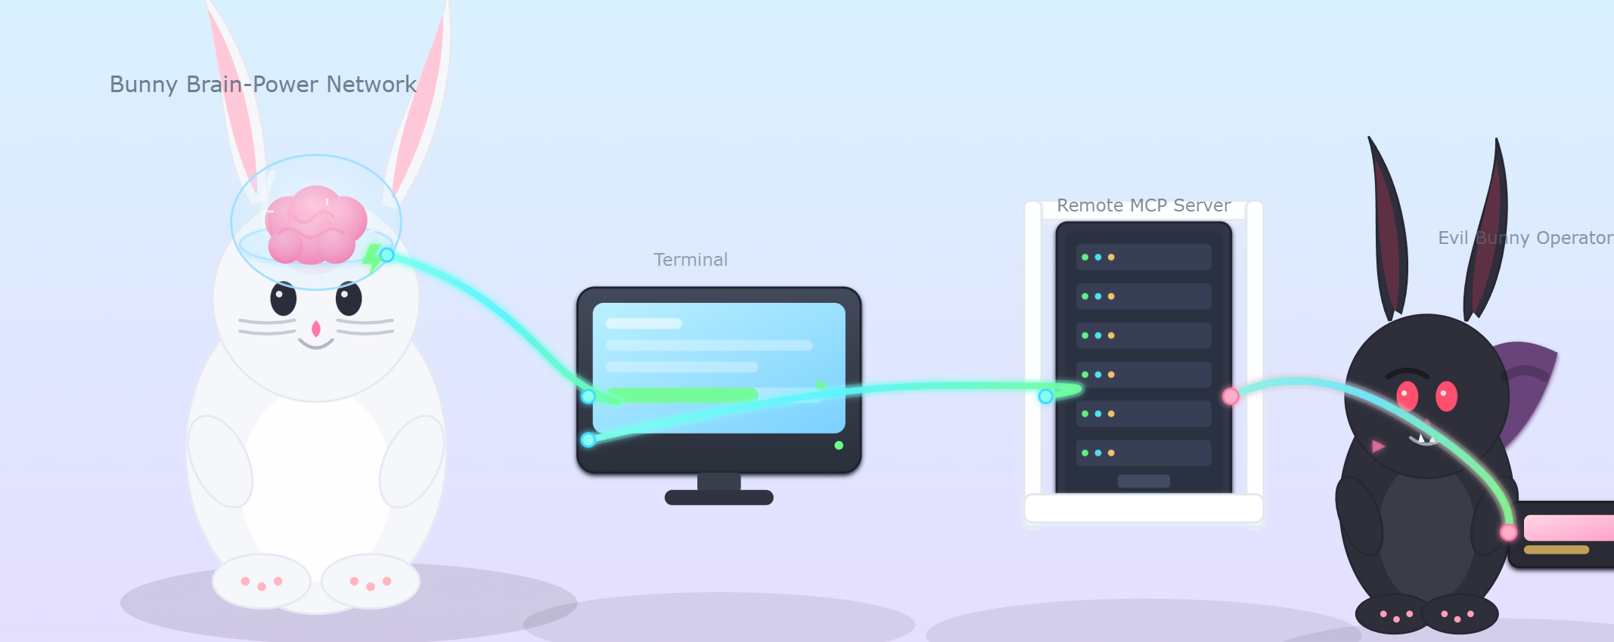
Do not leak your company’s secrets to third-party Remote MCP Servers.
Connecting to other people’s remotely-hosted MCP Servers is a massive security risk.

Slide 19
Do not eval() LLM-generated code.
Example: a command-line-interface MCP Server.
LLM
Terminal
CLI MCP Server
This would defeat a major advantage of MCP over Terminal execution!

Slide 20
Resources
https://github.com/modelcontextprotocol/python-sdk/
https://code.visualstudio.com/api/extension-guides/ai/mcp

